Slide 1
Samsung Color E-Paper
First-time-use guide

Slide 2
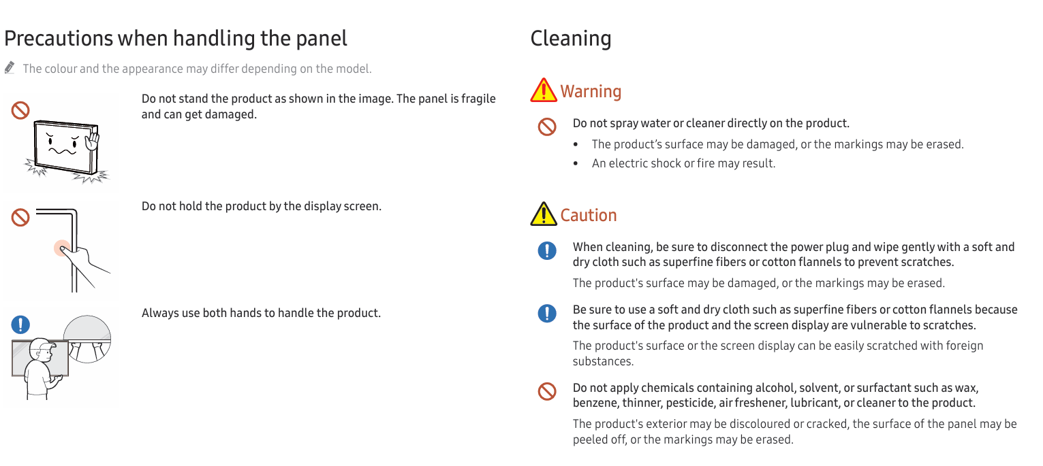
Before you start – read attentively

Slide 3




Before you start – read attentively
Expected Response Times:
    Initial Refresh: Approximately 41 seconds for the first image refresh.
    Total Cycle Time: ~1:46 minutes for two complete refresh cycles.
Content Cycling: ~1.17 minutes to cycle through content stored in internal memory after pressing the play button.
  Average response to input: 20s
  Average refresh time: 40s or more depending on content
Image Appearance: In some samples, images may take up to 2 minutes to appear, requiring occasional manual intervention (e.g., pressing the Control button).
Patience is key
E-paper technology introduces a new display paradigm that takes getting used to. It is essential to give the unit time to respond!
Please refrain from clicking buttons in rapid succession: it will not yield desired results and potentially make a full power cycle necessary.
Setup and Operation:
    Power On: Connect the display to a power source and turn it on using the power button. Make sure to use the port labeled with the symbol!!
    Connectivity: Use the USB cable to connect the display to your device or insert a USB drive directly into the USB port.
File Compatibility: Ensure your files are in supported formats (jpg, jpeg, png, bmp) and resolutions (2560x1440).
Content Playback: Press the play button to initiate image refresh
Tips for Optimal Use:
    Patience is Key: Allow sufficient time for the display to process and refresh images.
    Troubleshooting: Refer to the detailed guide for additional troubleshooting steps if needed.
    Handle with care: The panel technology is fragile. Always handle with two hands.

Slide 4
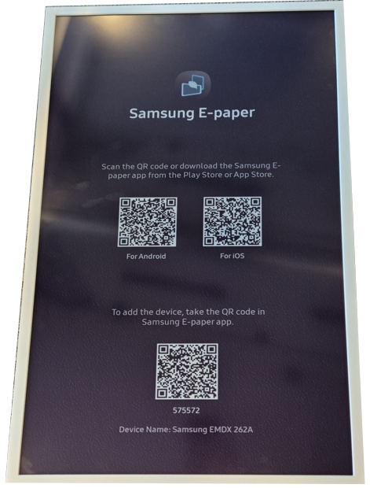

Useful resources
Download the mobile e-Paper app using the QR codes displayed on the device
Before connecting with a device running <1100.00, find the user manual and Firmware files on
https://www.samsung.com/nl/support/model/LH32EMDIBGBXEN/ . We recommend v 1100.0 or higher for the best user experience.

Slide 5
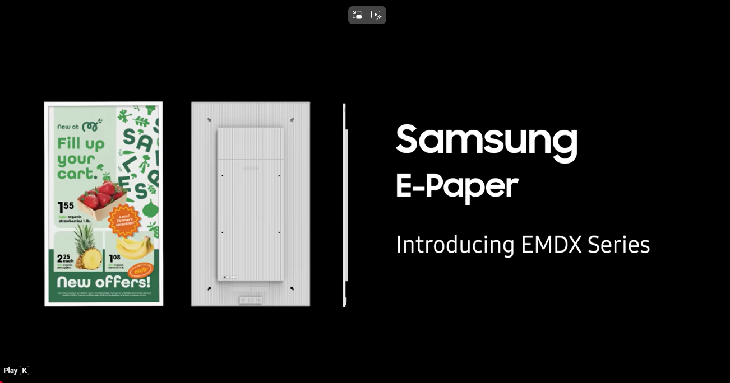
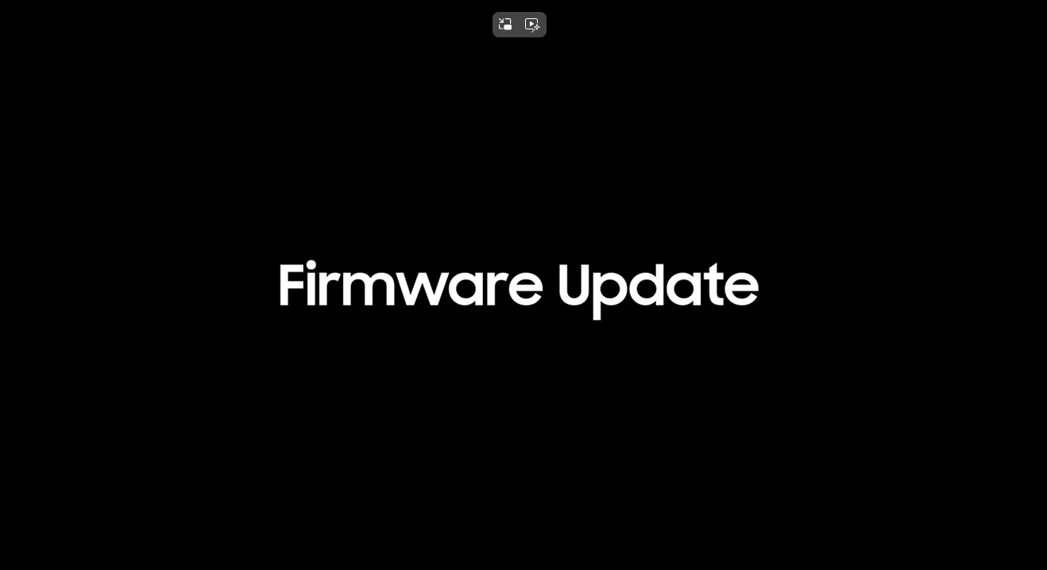
Useful resources
Watch OOBE Process on YouTube
Firmware update section: here

Slide 6
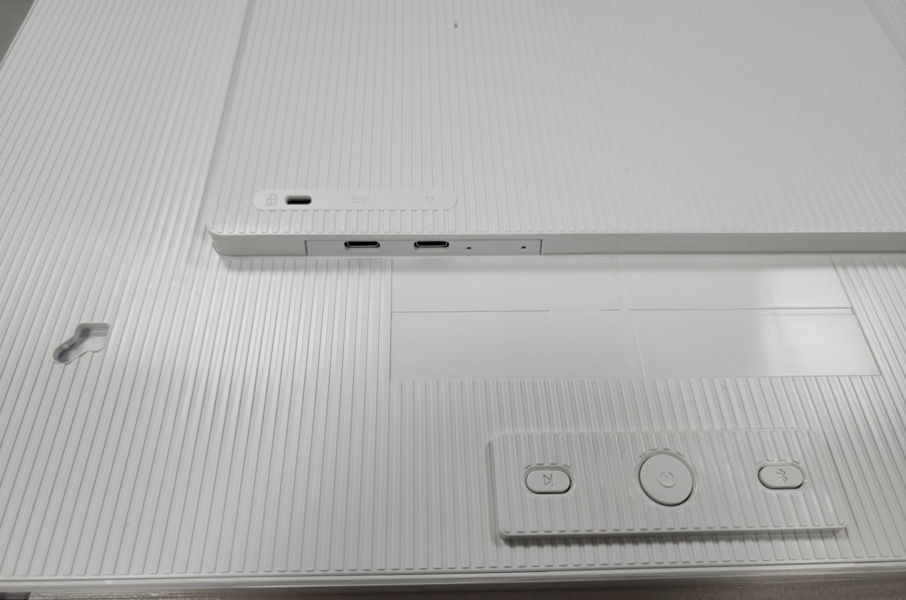
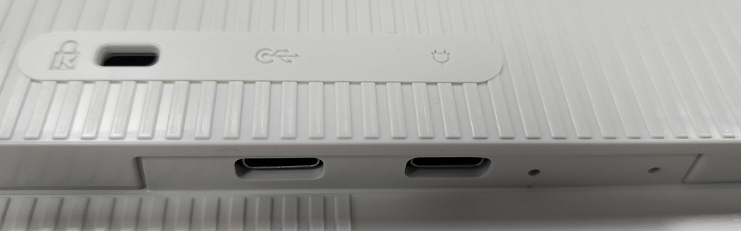
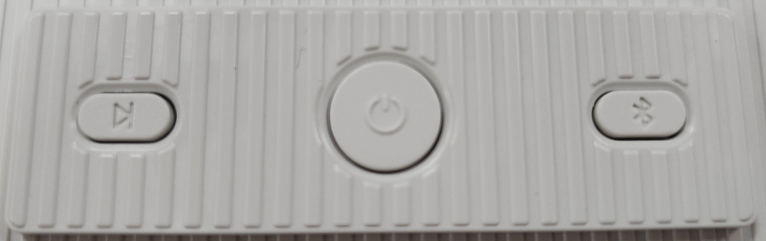
HW Components
Kensington
Lock
Red LED for Power
Blue LED for Network
Green LED for Control
USB-C 2.0 (Data only)
USB-C
(Power Only)
Control
Power
BT Pairing

Slide 7
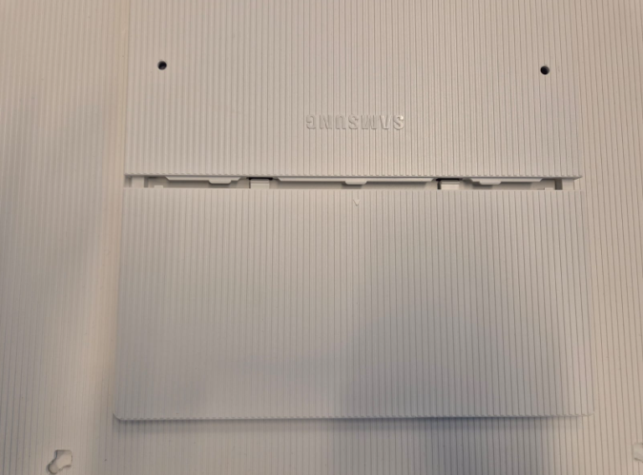
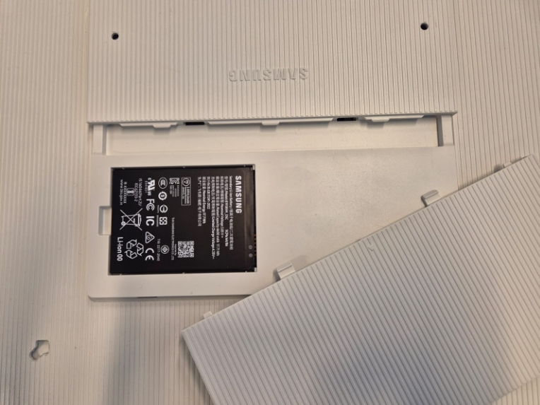

Insert / remove battery
Make sure the e-Paper lies on a flat, even and soft surface.
Gently press down on battery hatch tabs and slide open in the direction of the arrow.
Remove the battery by lifting it at the cutout.
Align battery pins with e-Paper pins

Slide 8
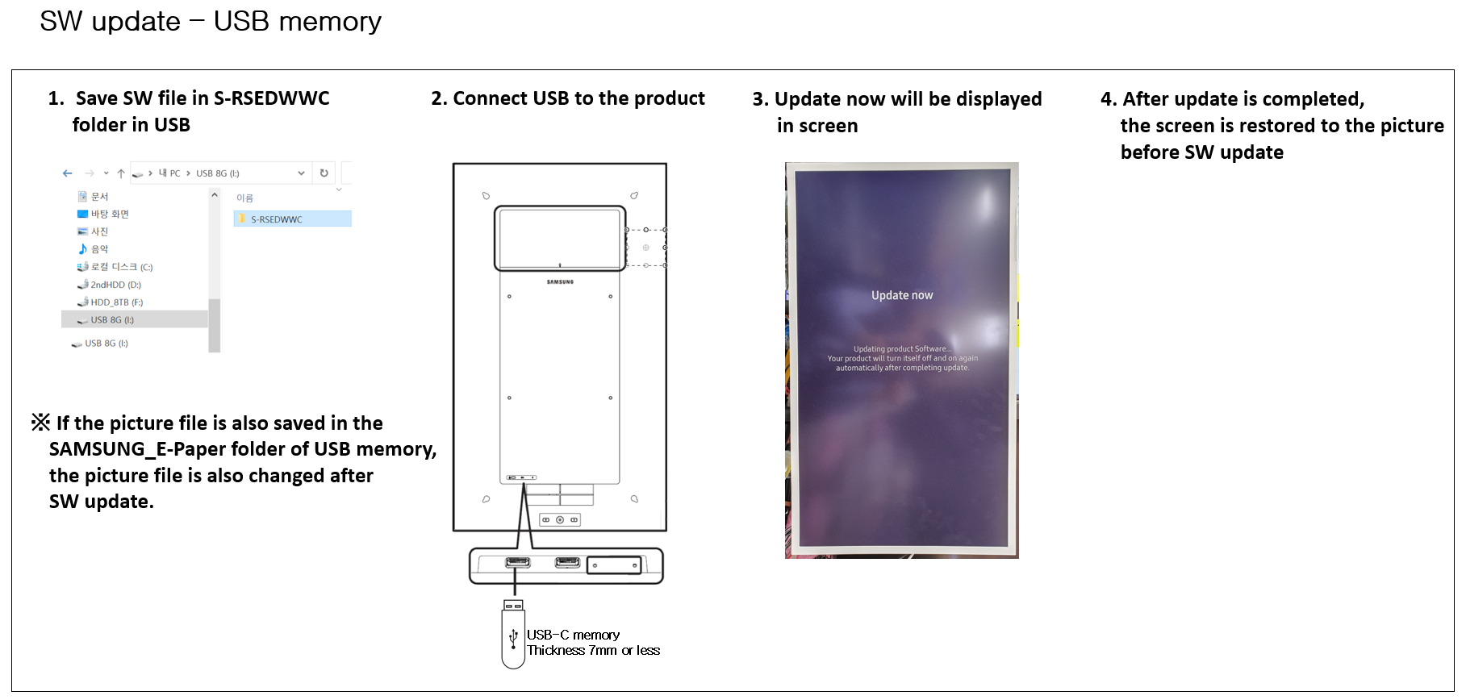
Update Firmware first (1/3)
FW update using USB method - RECOMMENDED
(!) Procure fitting USB key

Slide 9
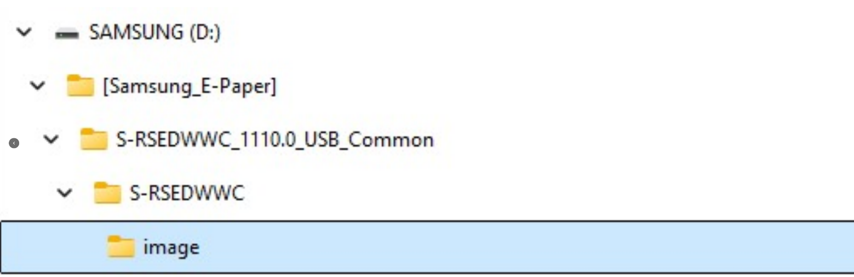
Update Firmware first – USB (2/3)
USB key requirements:
USB C
Below 7mm thick
FAT32
<128GB
Folder structure requirements
A folder containing a version number will be downloaded. It only serves as a container, allowing version distinction
on your hard drive.
(!) Place only these folders in USB root, do not change folder tree.

Slide 10
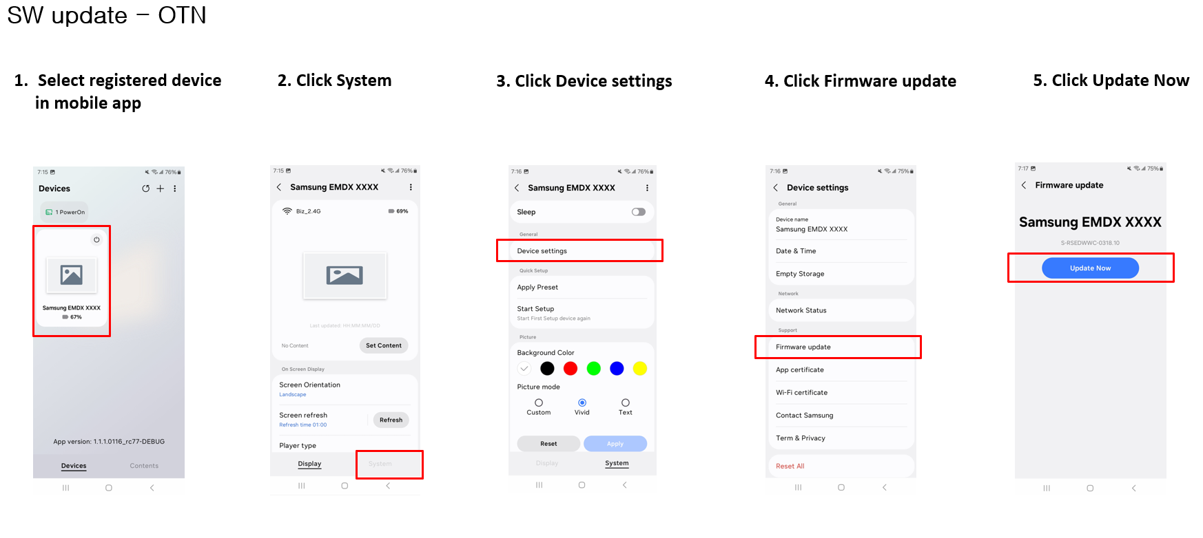
Update Firmware first (3/3)
FW update using OTN method – SUBJECT TO NETWORK CONDITIONS

Slide 11
Connect using mobile app
Phone hotspot – SUBJECT TO NETWORK CONDITIONS
Many issues occur due to the missing ARP functionality in mobile phone hotspots. Where you can, use POE+ or a wireless access point & router with an open network connection and access to the cloud
USB preset
A USB preset method is available, allowing you to skip the OOBE process via mobile phone.
Contact your technical resource for more information.

Slide 12
Patience is key
(!) Write down initial pairing code for later connection with additional phones. It will change after every factory reset.
1° Initial setup
Press the power button once and wait. When the QR codes appear (this can take up to a minute or more), follow the in-app process.
2° Resume from Deep Sleep
Press the Power Button once.
you will see the Green led flashing for about 5-10 sec. The status LED switches off.
Wait up to 1 minute until the device is fully awake and you can control it from the Mobile app.
3° Factory reset – bring up the splash screen with QR codes
(!) Keep the Power cable attached
Press and hold the Control + BT buttons for 10 sec
Wait 5 seconds
Press the Power button for 2 sec
The reset procedure starts (it takes about 10 sec – you will see the status led change colors during reset,
(from green to blue) and the QR codes will appear.
PLEASE NOTE: Always plug in the power cable, even if the battery is full!!

Slide 13
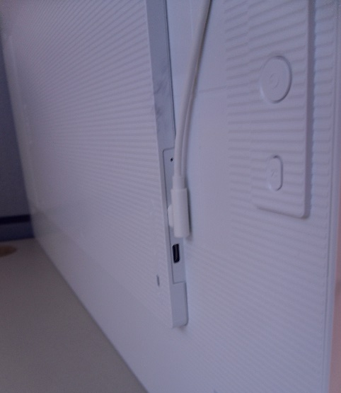
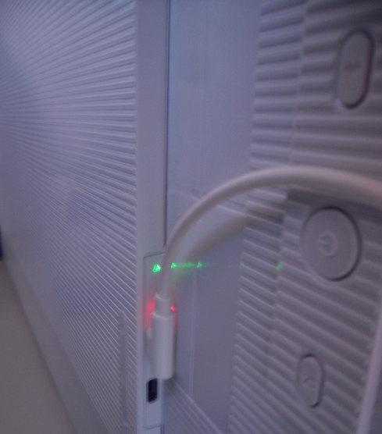
USB content upload
Plug in the charger to the upper (charging) port ①
EMDX will start boot up.
Current PV sample always refresh an image twice.
After applying power first image refresh starts approximately after 41 seconds. The second refresh approximately after 1.29 minute and the total cycle of two times refresh is fully done after approximately 1:46 minute.
After pressing play button, to cycle through the content on the internal memory, it takes on average 1.17 minutes before the EMDX responds and has completed it’s (2x) refresh cycles.
In some samples, if you can’t see any image after 2 min,
press Control button below Power button.
Plug in the USB with images (Type-c connecter needed) to port ②
Create a folder in the external storage,
Folder name: root > “SAMSUNG_E-Paper“
Put the images in the folder. Multiple images are also possible.
File type: jpg, jpeg, png, bmp
Resolution: 2560x1440
Only landscape is supported. In case of portrait usage you need to rotate you content 90 degrees counter clockwise.
When EDMX is powered, it will detect the insert of a USB-C flash drive and
automatically overwrite the internal storage location. In order to start showing the new loaded content you must perform a power cycle.
To change the image, please press the Play button, below the Power button.
①
②
①
②
2560x1440 image
2560x1440 image

Slide 14
Next steps
Congratulations! You just completed your first succesful Samsung E-Paper demo!
To fully master this amazing device and its many applications, please refer to the online user manual, your CMS partner, or your commercial or technical contacts at Samsung.

Slide 15
Addenda

Slide 16
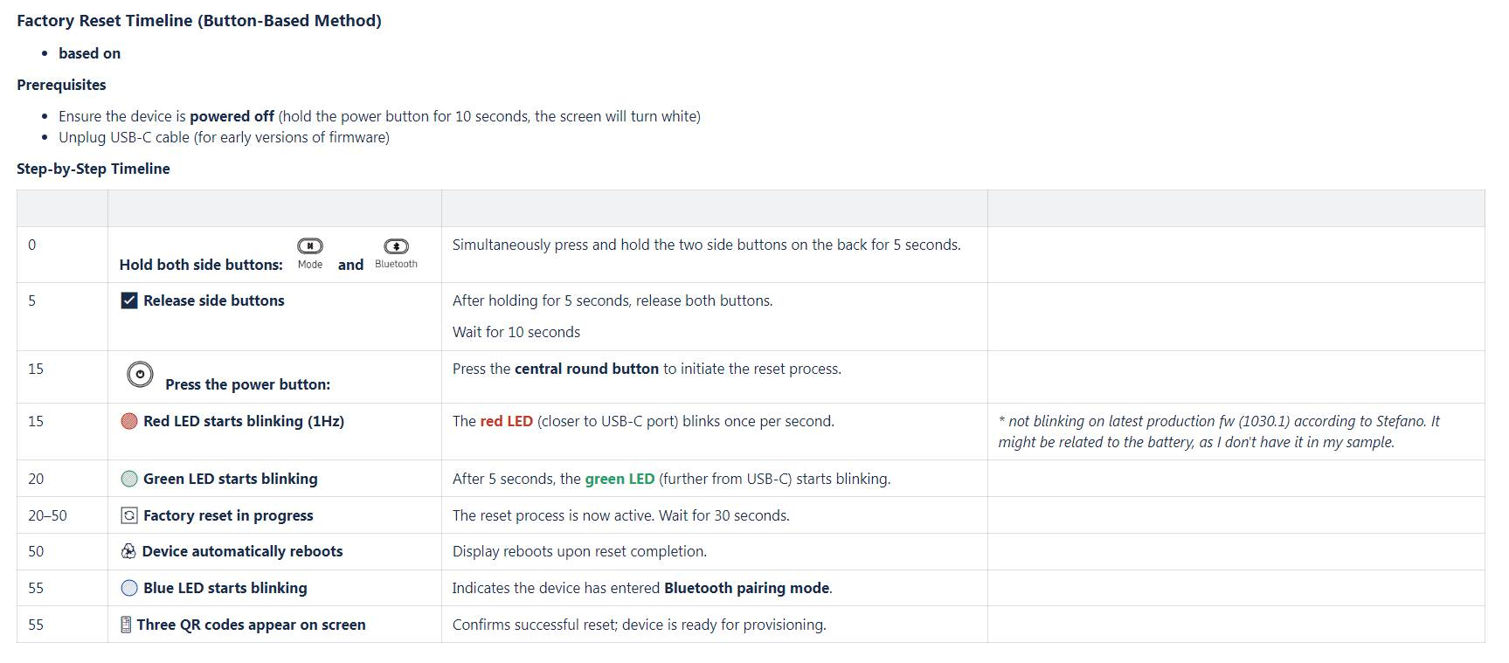
Patience is key

Slide 17
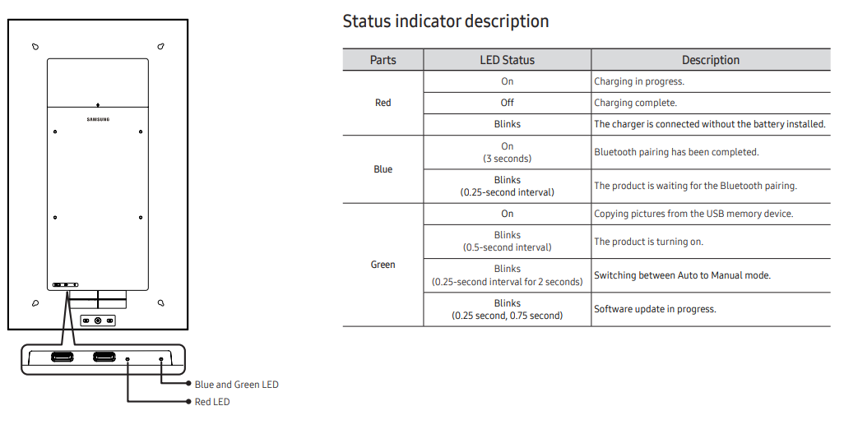
Status codes

Slide 18
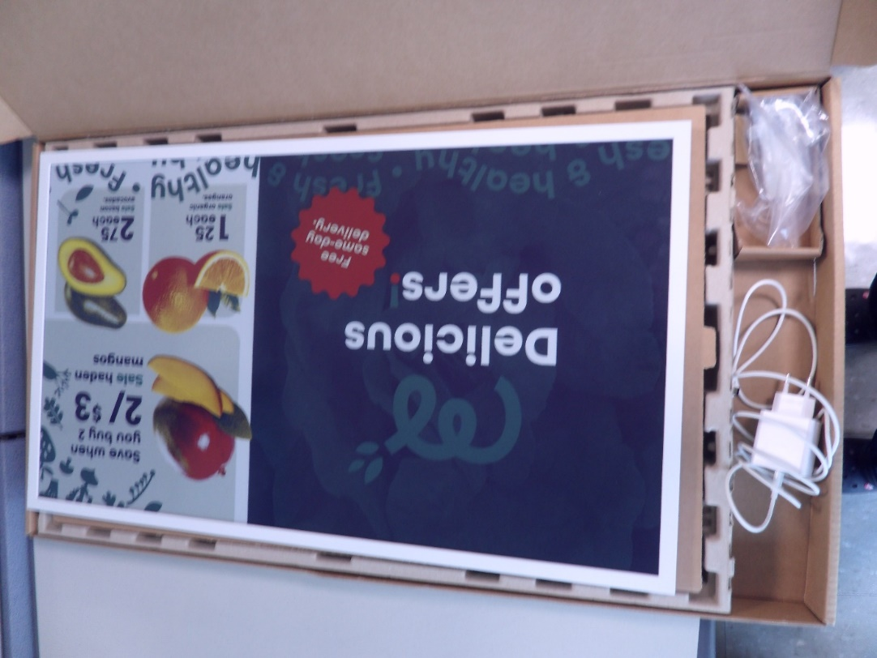
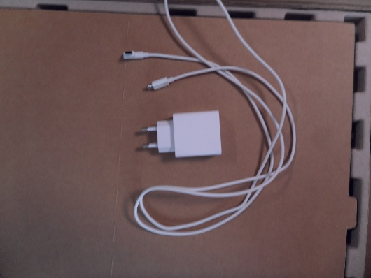
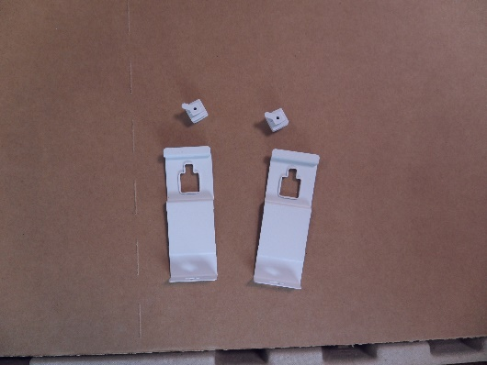
What to expect inside the package:
1 e-paper set
1 adapter / charger
2 hanging brackets
2 holder rears
Please take extra care with the set – it’s fragile

Slide 19

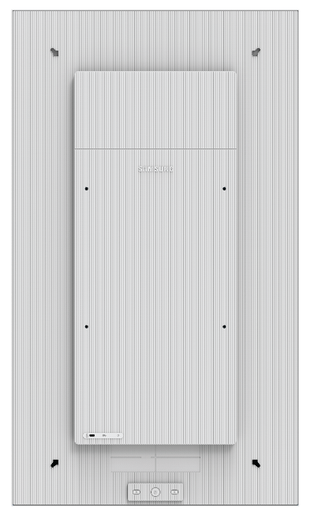
Design
8.6
9.3
Wire connection hole
Battery Cover
VESA
200x200
3- buttons
Power / Control / BT Pairing
Size | 32”
Product Size | 727.3 x 422.7 x 17.9 mm
Weight | 2.3 kg (excl. Battery) 2.4 kg (incl. Battery)
Kensington
Lock
3 color LED
Indicator
2x USB-C
Adaptor / Data

Slide 20
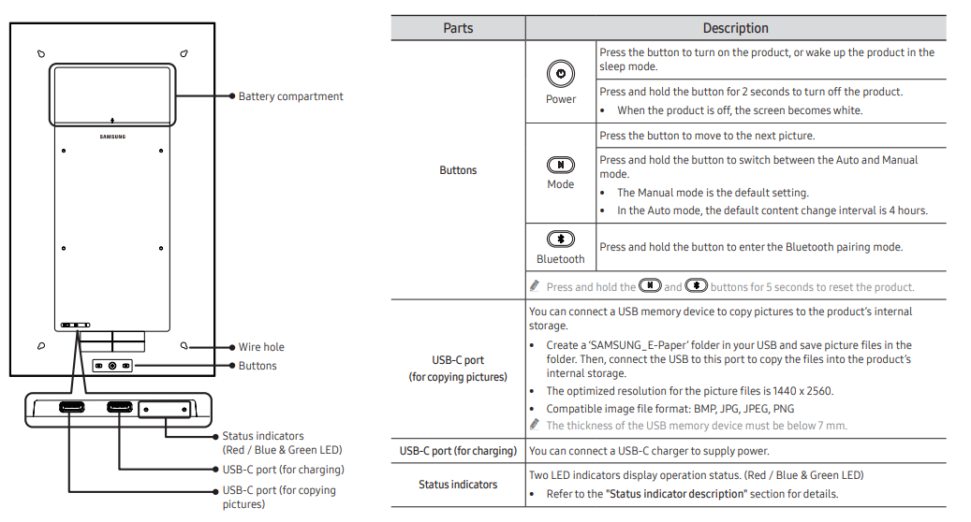
How to operate

